Slide 1
How to Access Successmaker and
Math Assignments
Bayview Elementary School

Slide 2
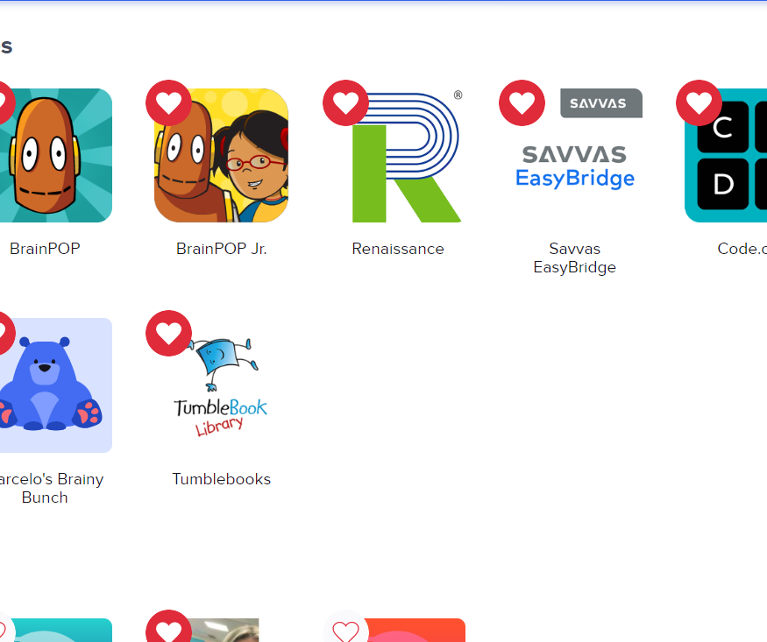
Clever Dashboard
Click on “Savvas Easy Bridge”

Slide 3
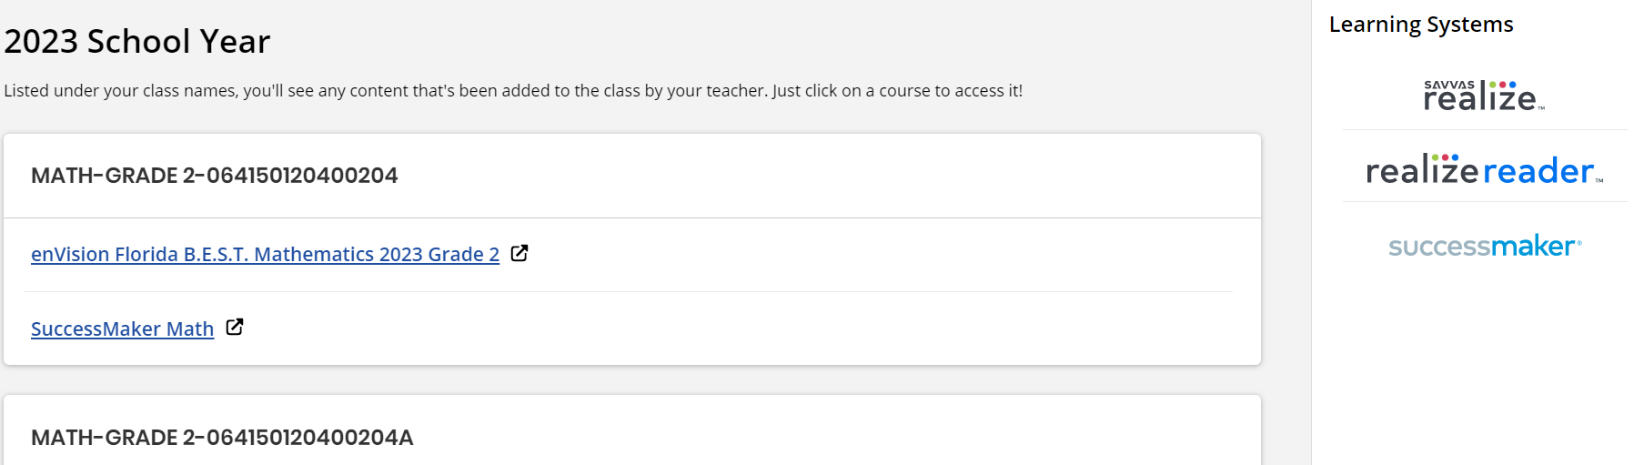
Click on:
“Successmaker”

Slide 4
Assignments/Explore
Part of the Savvas Easy Bridge

Slide 5
Click on:
“realize”
This will bring you to two choices. Assignments and Explore

Slide 6
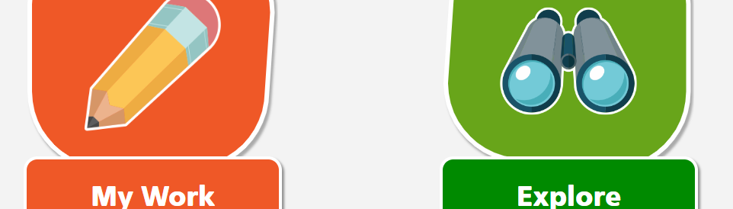
Realize Dashboard
For assignments, click on “My Work”

Slide 7
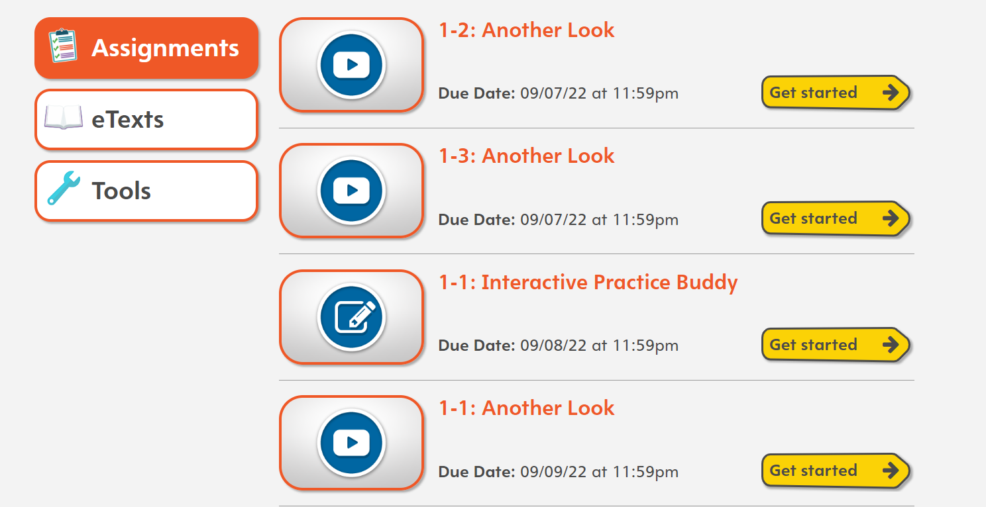
Choose one of the assignments

Slide 8
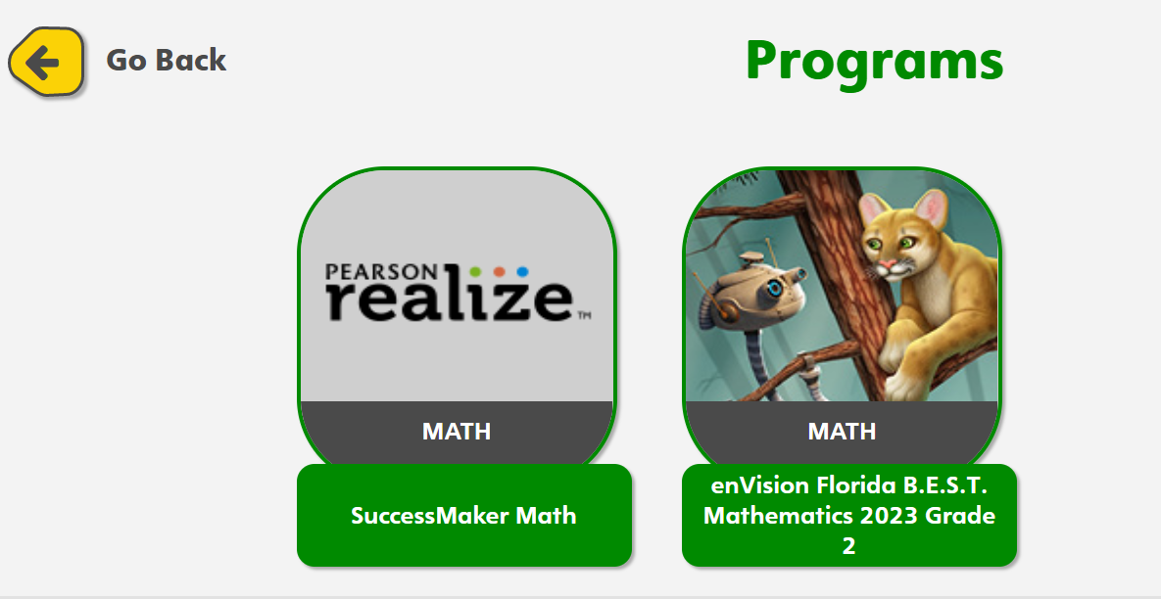
Choose the one you want

